Slide 1
Development Environments
Enables Efficient Coding

Slide 2
What are Development Environments?
“A development environment is a set of tools for developing software” - by ./missing-semester
They come in two strands: Integrated Development Environments (IDEs) and terminal-based workflows
Today we will be introducing Vim as a terminal-based workflow and VS Code as a convenient IDE

Slide 3

About Vim
Stands for “vi improved”, vi is a old text editor developed for Unix operating systems
The idea behind it is to allow users to edit text fast without switching between mouse and keyboard
You will need it in situations where you don’t have access to IDEs (e.g. terminal-only virtual machines if you take the Operating Systems course!)

Slide 4
What are Development Environments?
Insert
Vim has different operating modes for different type of tasks:
  Normal: for moving around & editing in a file
  Insert: for interesting text (i)
  Replace: for replacing text (R)
  Visual: for selecting blocks of text (v/Ctrl-V)
  Command-line: for running a (vim) command (:)
You can switch back to Normal mode by pressing <ESC>
insert
:
Esc
Command
Normal
Esc
Esc
visual
Visual

Slide 5
Vim basics - Useful commands
In order to save your changes, etc., you will need to run some commands in the command-line mode:
  (:)w - save
  (:)q - quit
  (:)wq - save and quite
  (:)q! - quit without saving, esp when you are trapped in Vim
You can also think of Vim as a programming language, and it provides many more powerful features that allow you to edit a file really fast
https://missing.csail.mit.edu/2026/development-environment/#text-editing-and-vim

Slide 6


What are IDEs
An IDE brings the following functionalities into one application:
  Syntax highlighting
  Type checking
  Code formatting
  Autocomplete
  etc.
Commonly used ones:
  VS Code - Good for daily programming
    https://code.visualstudio.com/
  IntelliJ - You will need it for your Java courses!
    https://www.jetbrains.com/idea/

Slide 7
Besides the IDE…
IDE is only an editor, and it cannot run you code directly. You will need to download the language compiler/interpreter.
Language specific supports are offered by IDE extensions that implement Language Server Protocol. You can download them in VS Code.

Slide 8
Commonly Used Features
If you need any help, do not hesitate to ask!

Slide 9
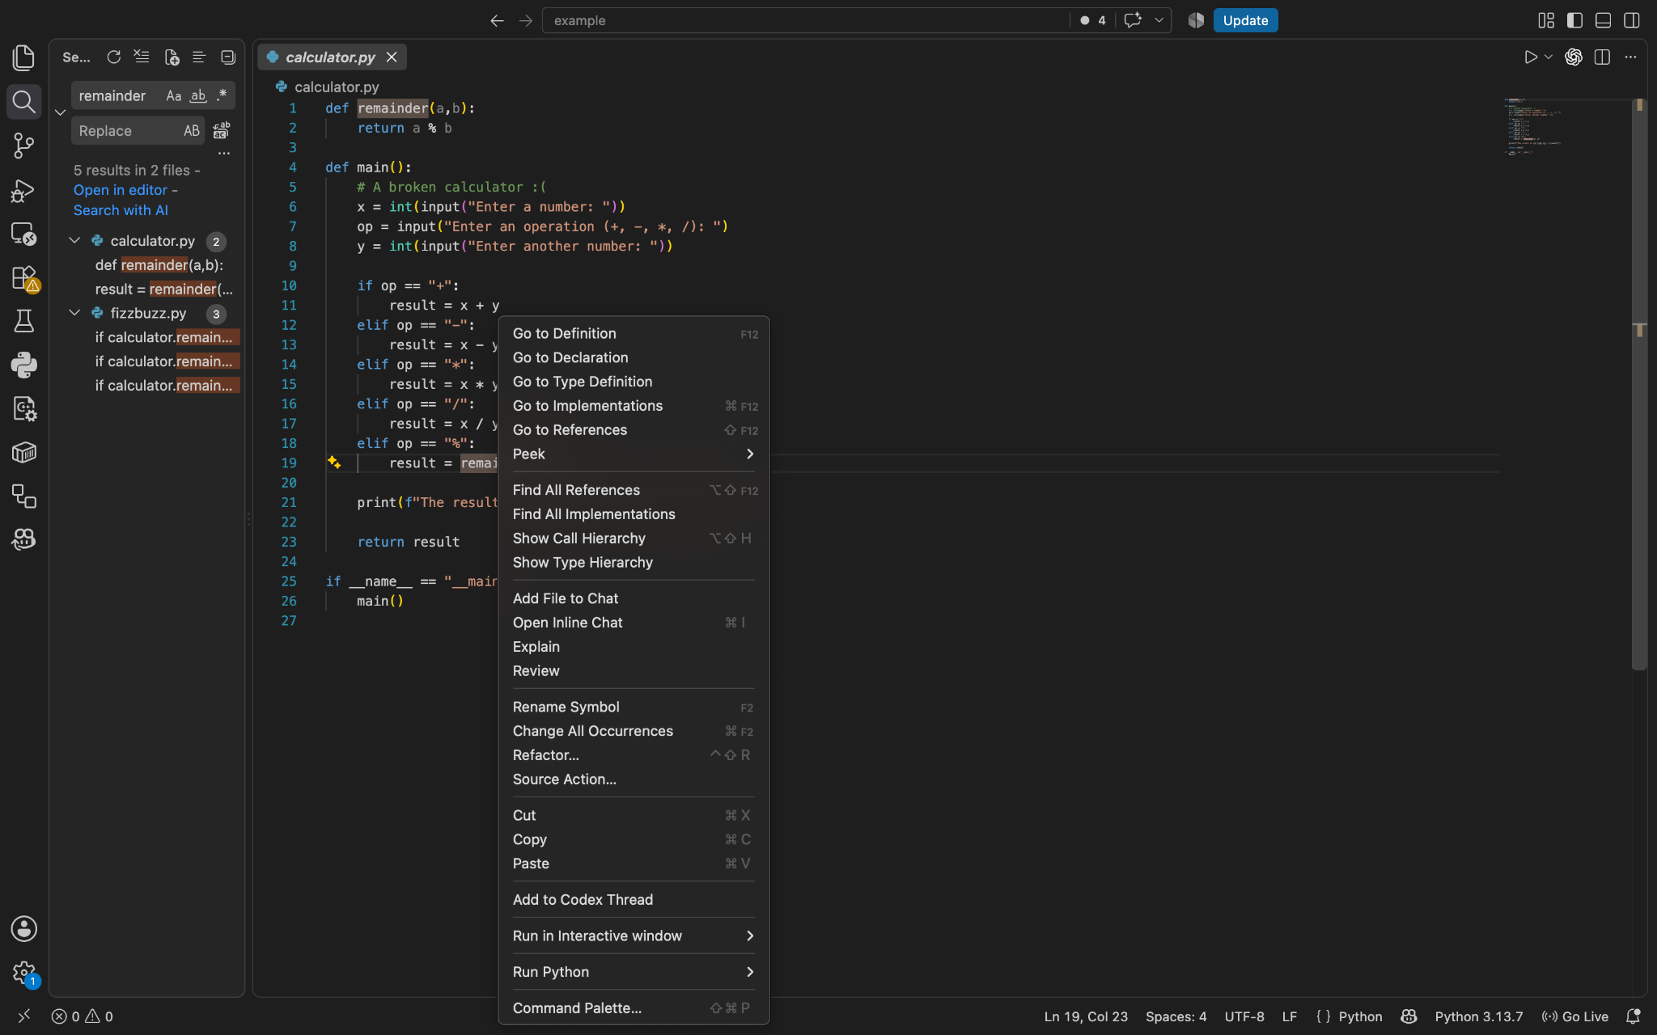
Search/Find Reference/Go to Definitions
There are several ways:
  Right click a symbol, and the options pops up
  Use Cmd/Ctrl + Click on a symbol
  Use the search functionality
This is very helpful when you have a large code base to deal with

Slide 10
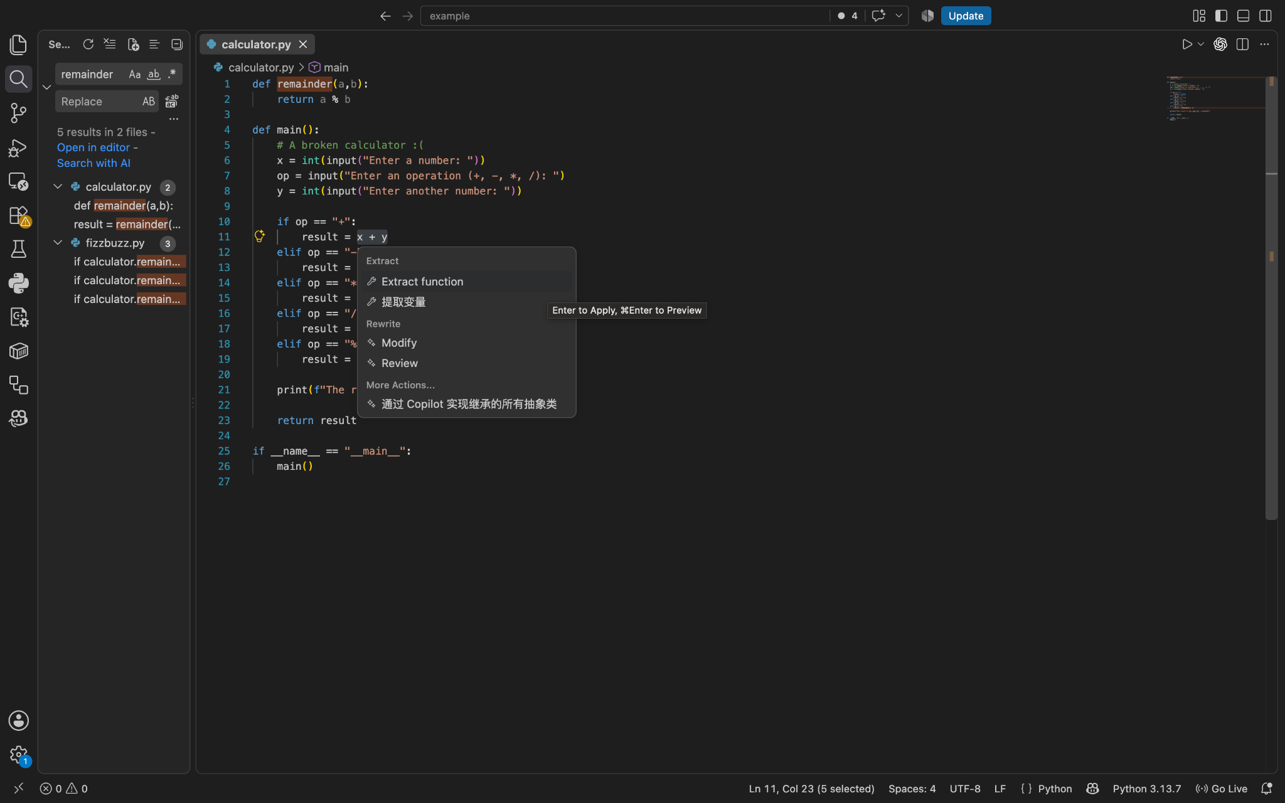
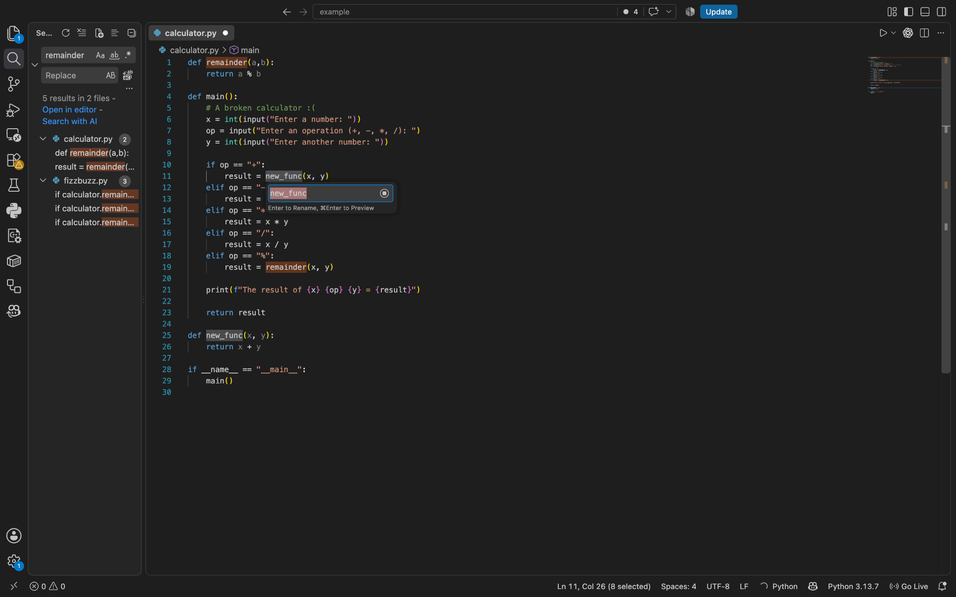
Code Refactoring
Refactoring typically includes:
  Rename a symbol for its all occurrences
  Extract constants
  Extract variables
  Extract methods
You can do this by selecting a text section, click the lightbulb icon or just select ‘Refactor’ after right clicking

Slide 11
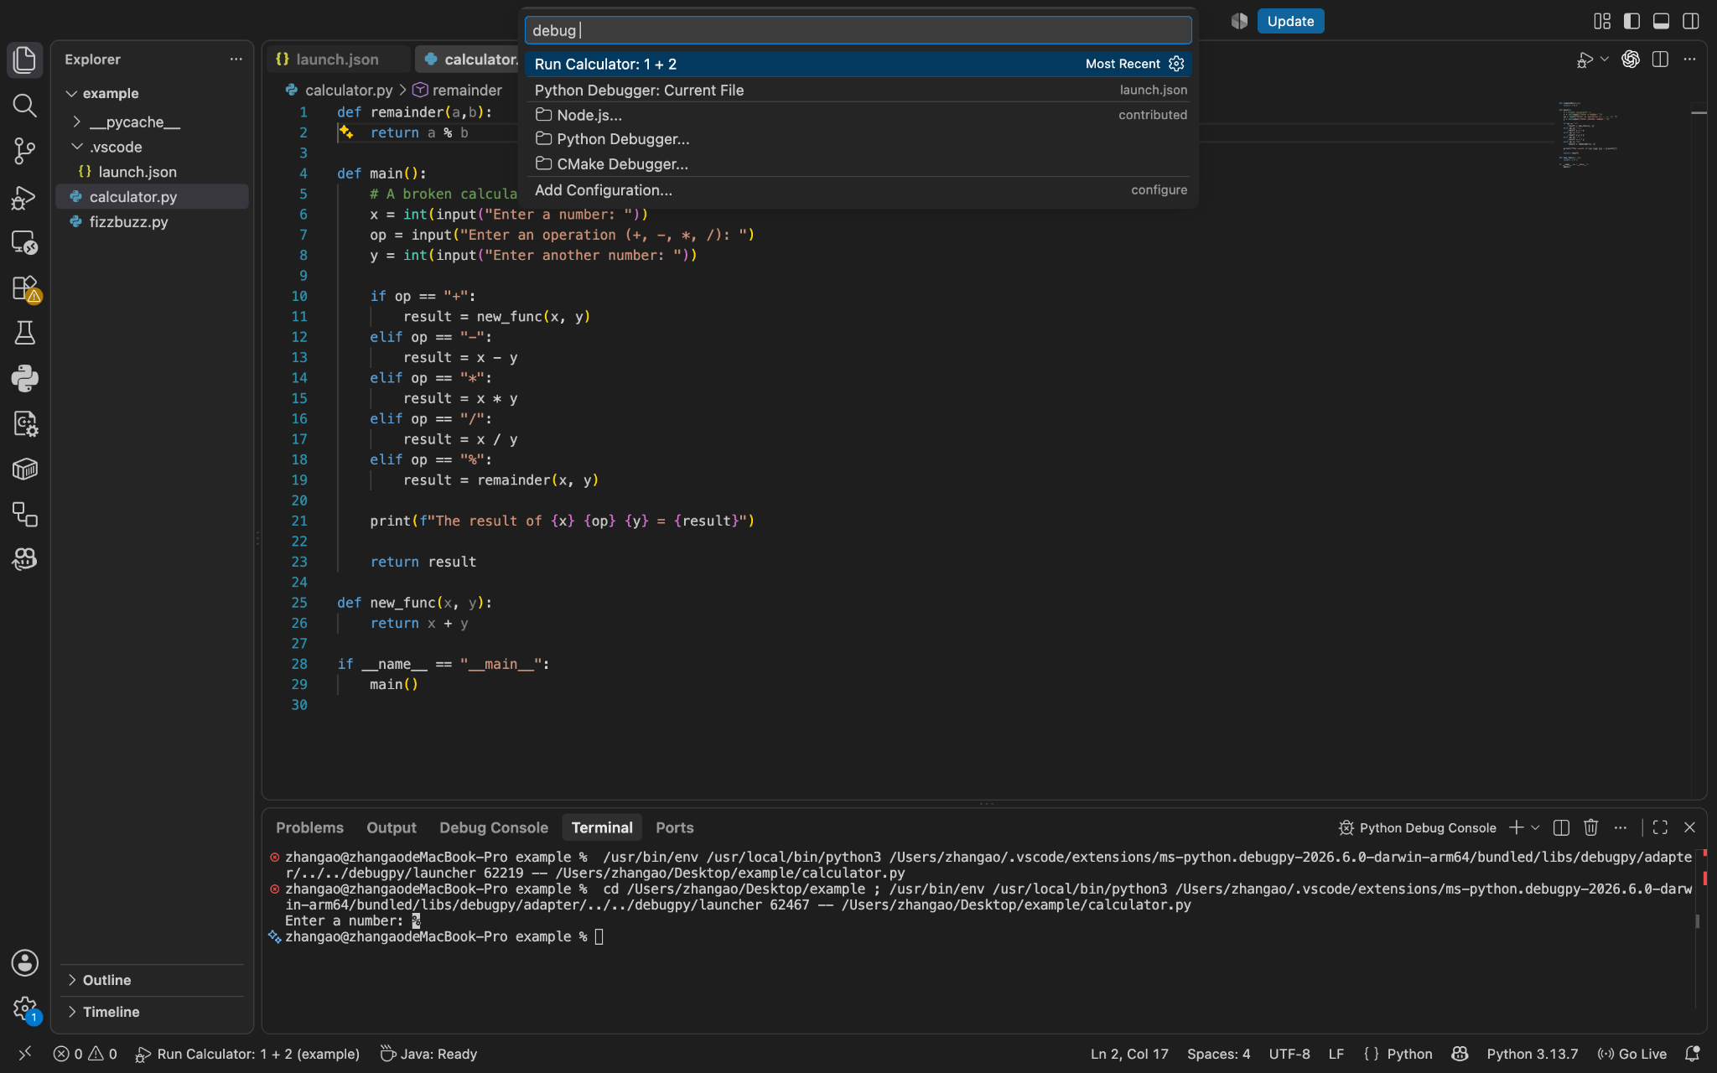
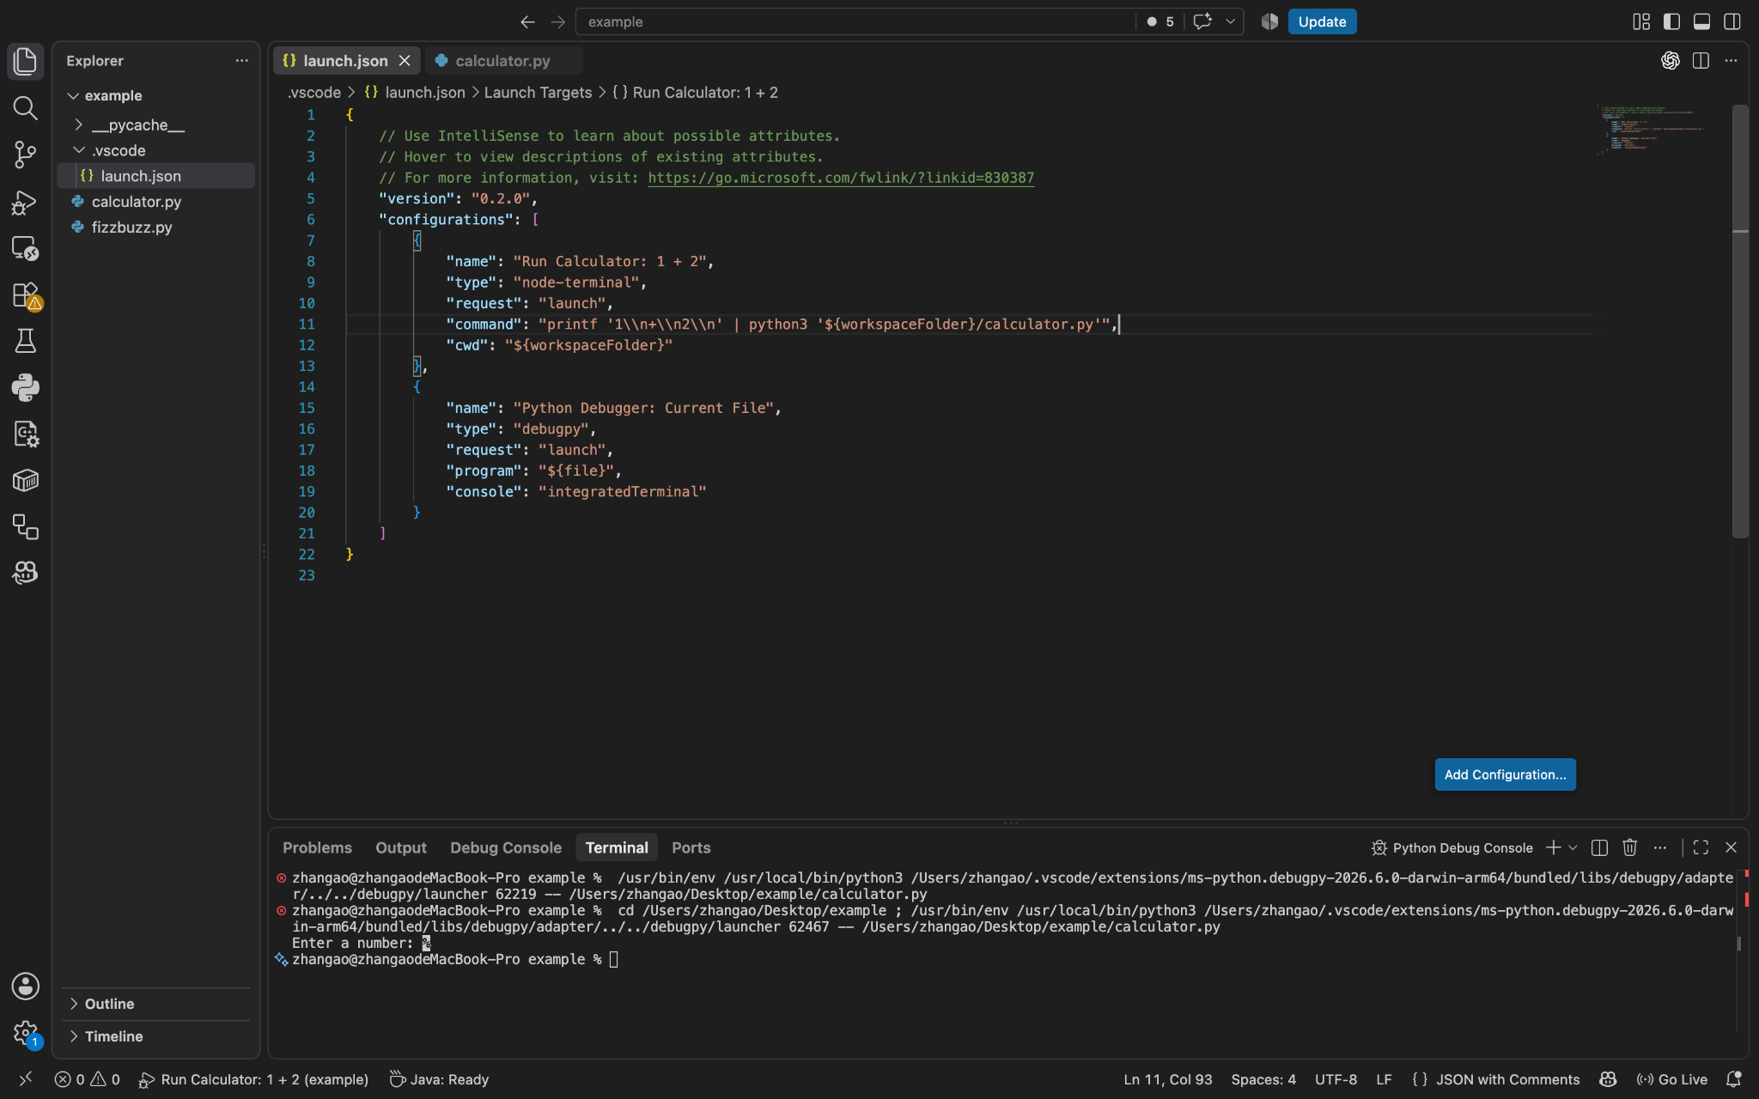
Running Code
You can customize how to run your code by modifying launch.json
  What files to run
  What command to use
  What parameters to use
  …
This could be helpful when you are debugging your code

Slide 12
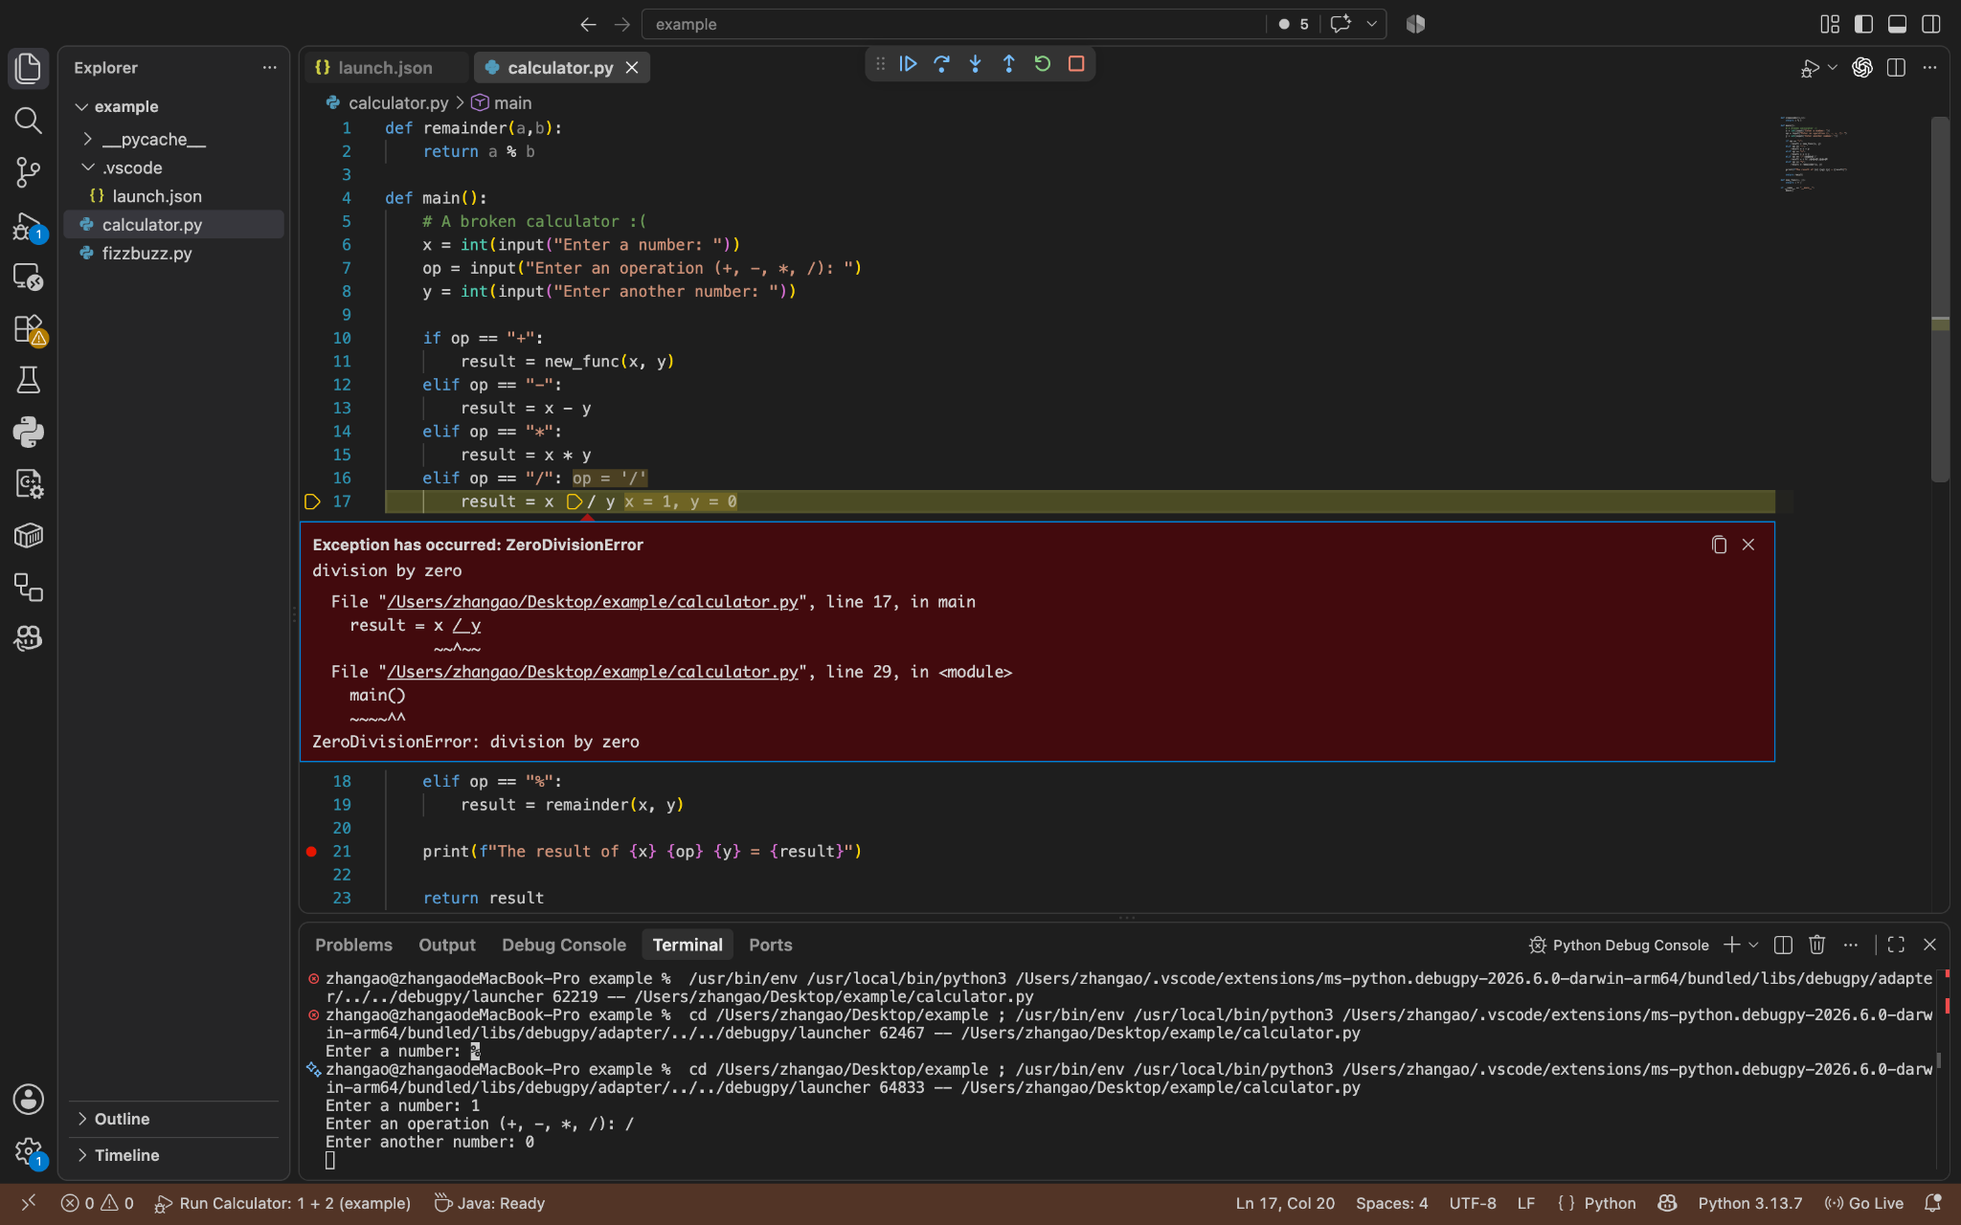
Debugging
Like other IDEs, VS Code has built-in support for debugging
We can add breakpoints (points where programm will be stopped), inspect values, and run programs step by step.
As shown, any runtime errors will be catched!

Slide 13
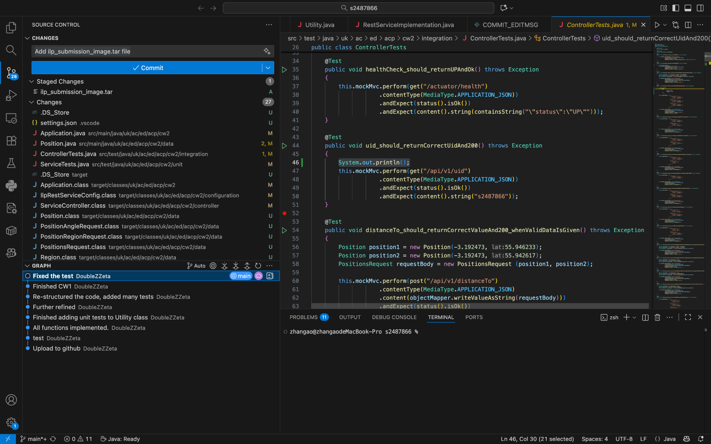
GUI for Version Controls
IDEs provide you with GUI for Git, so that you don’t have to remember all the commands
In IDEs, you have
  Branch visualisation
  Easy commit and push
  Get an interface for code merging

Slide 14
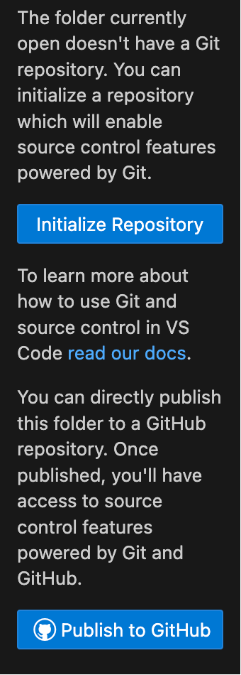
Setting Up Git In IDEs
Using VS Code, you can
  Install Git (if you have not already do so)
  In your terminal, config git
    git config --global user.name “name”
    git config --global user.email “email@exaple.com”
  Then you can either:
    Clone a project from remote
    Open a local project and publish repository (set up git repo for you)

Slide 15
EXERCISES
Now we are going to put this into practice!

Slide 16
Exercises
Open VS Code and download Python extension
Open a terminal in VS Code, and clone the project <link_to_be_updated> to Desktop
Use the refactor functionality, extract all four other operators (+,-,*,/) into functions
Make sure those functions are named properly (add, minus, multiply, divide)
Add a breakpoint at line printing the result
Either use the debug mode directly (then manually input the values 1, /, 0) or using the launch.json provided under /.vscode, enter the debug mode
Continue executing the program until you see the error
Now, identify the error and fix it!
Push the changes to your github (?)
Notes:
cd ~/Desktop
Mkdir PracticeGit
git init
cd PracticeGit
git status
: > Me.txt
git add Me.txt
git commit -m “initial commit”
echo "Hello! :) My name is <your name>" >> Me.txt
git add Me.txt
git commit -m "add my name"
echo "I study <degree>" >> Me.txt
touch Colors.txt
git add Me.txt
git commit -m "add my degree"
git add Colors.txt
git commit -m "add Colors.txt file"
git log --pretty=format:"%h | %an | %ad | %s" --date=short
git diff $(git rev-list --max-parents=0 HEAD) HEAD
(On github)
echo red green blue > Colors.txt
git add Colors.txt
git commit -m "add my 3 favourite colours"
git push
cd ~/Desktop
git clone https://github.com/infpals/Git-Basics.git
cd <WORKSHOP_REPO>
git log --oneline

Slide 17
There are more features to be explored…
VS Code also includes other cool features such as
  Markdown preview
  Remote SSH (requires an extension)
  Agent coding (requires extensions), which we will take about next session
  etc.

Slide 18
Thanks for Coming!

Slide 19
What are Development Environments?
“A development environment is a set of tools for developing software” - by ./missing-semester
They come in two strands: Integrated Development Environments (IDEs) and terminal-based workflows
Today we will be introducing Vim as a terminal-based workflow and VS Code as a convenient IDE

Slide 20
Vim basics - modes of operation
Vim has different operating modes for different type of tasks:
  Normal: for moving around & editing in a file
  Insert: for interesting text (i)
  Replace: for replacing text (R)
  Visual: for selecting blocks of text (v/Ctrl-V)
  Command-line: for running a (vim) command (:)
You can switch to a mode by pressing the corresponding key in Normal mode, and switch back to Normal mode by pressing <ESC>

Slide 21


What are IDEs
Built-in highlights, Grammar checks
Fast edition, code refactoring
Customised running configuration
GUI for version control

Slide 22
Commonly Used IDEs
Intellij - powerful IDE designed for java projects
  Widely used in industries and universities
VS Code - lightweight IDE with many plug-ins
  The plug-ins allows it to have different functionalities

Slide 23
Downloads
You can download Intellij via
  https://www.jetbrains.com/idea/
You can download VS Code via
  https://code.visualstudio.com/

Slide 24
IDEs vs Compiler/Interpreter
Note that IDEs does not come with the language compiler / interpreter that you need for running programs
You would have to either download compilers / interpreters from the official websites or corresponding language plug-ins

Slide 25
Language servers
IDEs alone also don’t provide you with language–specific supports mentioned above
Those features are offered by extensions that implements language server protocol
For example, you can download the language extensions in VS Code

Slide 26
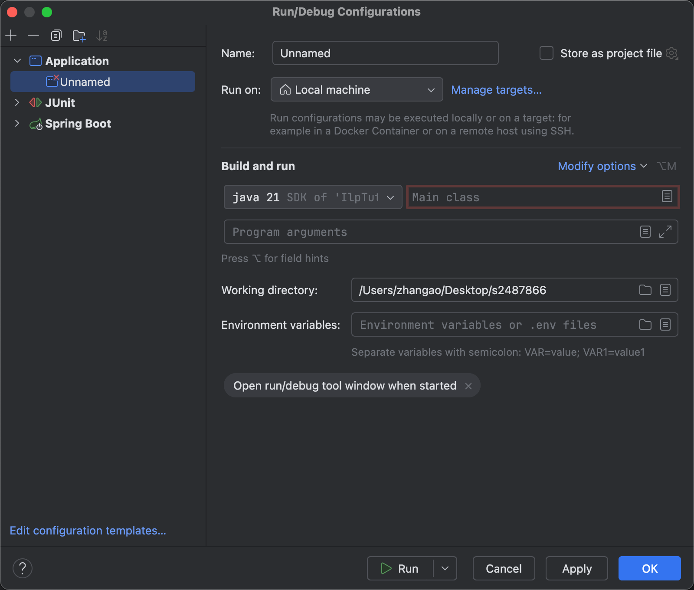
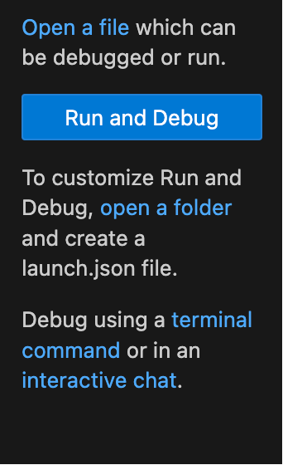
Customised Code Execution
Using IDEs, you can specify running configurations, for example:
  Which file to run
  File type of the program being run
  Arguments being passed to the program
  And more …

Slide 27
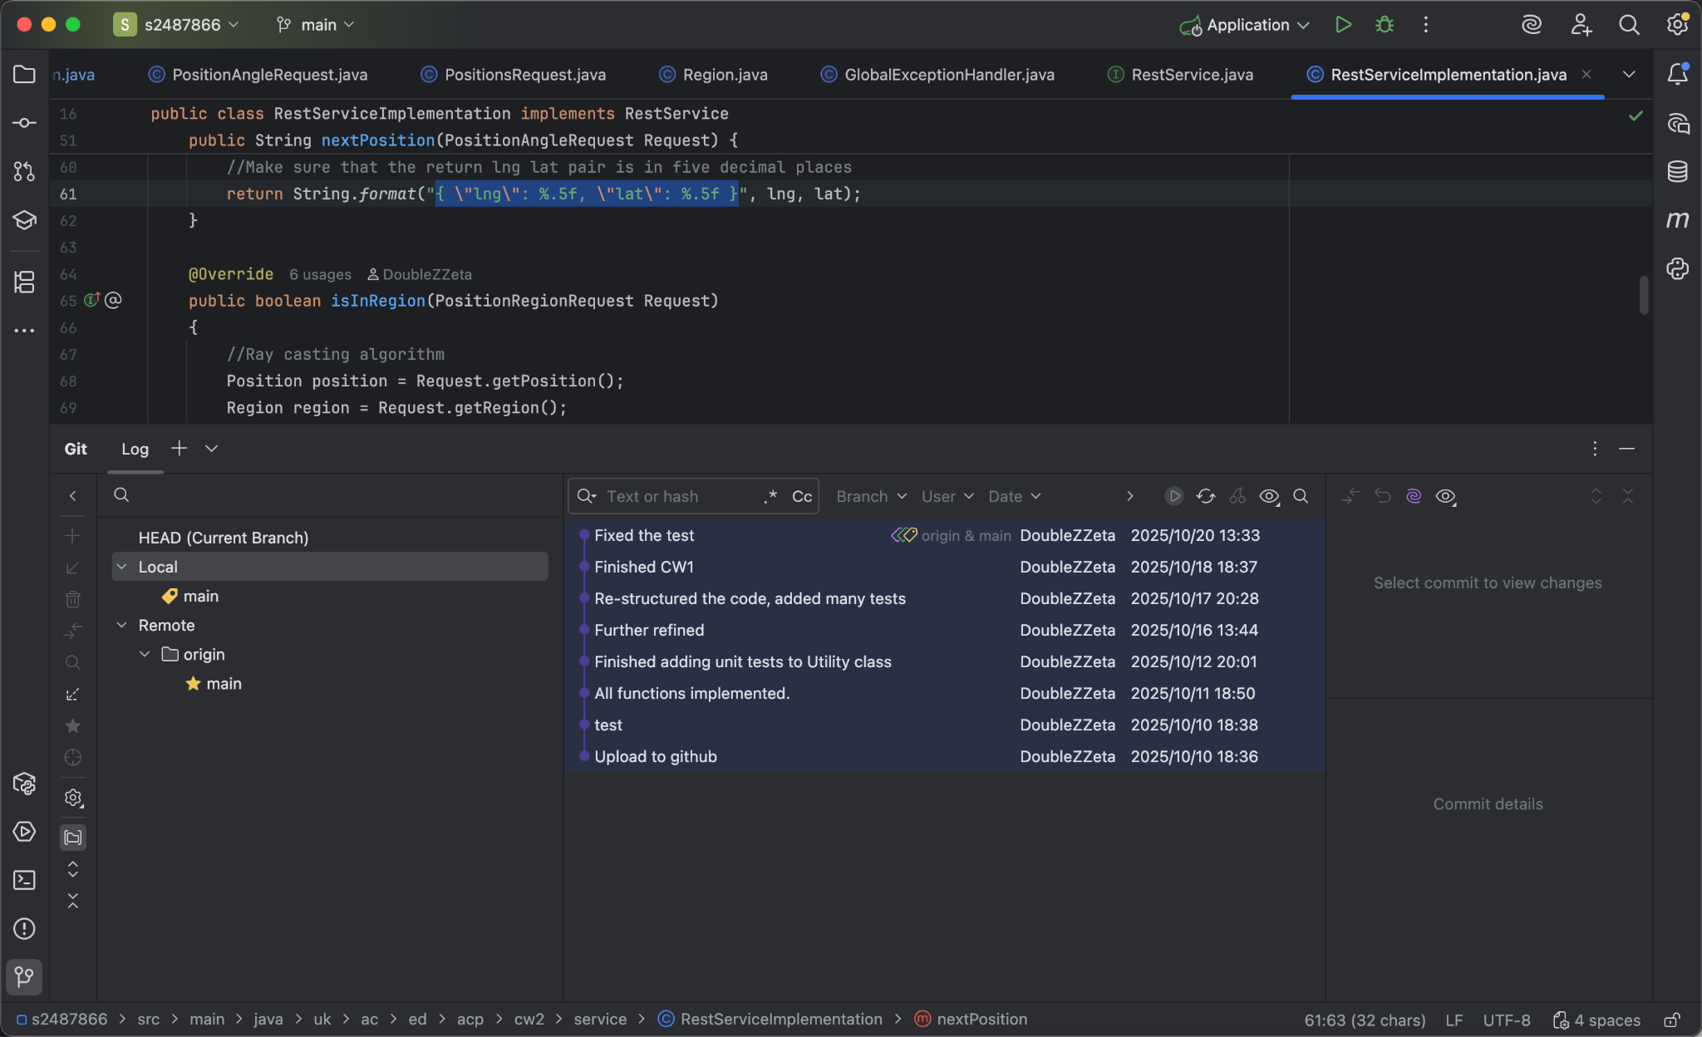
Setting Up Git In IDEs
Using Intellij, you can
  Go to settings -> version control -> github to add your account
  Then if you want to upload a local project
    Click the git icon at the bottom and initialise your repository
    Then go to Git -> GitHub -> Share Project on Github and initialise your git repo
  Or you can clone a project from GitHub

